Slide 1

Case Study :
Wellness Technology Company
By Santhosh P

Slide 2
PROBLEM
Overall daily use of smart device is considerably less given the data that is being recorded.
Incosistency when it comes to relationship between steps and calories burnt wrt to their sleep schedule.

Slide 3
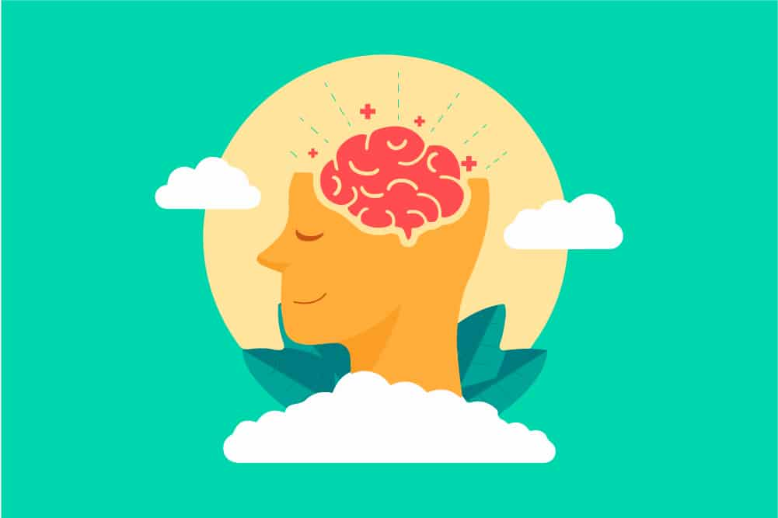
Analytical Goals
WHY: Perfect balance in relation between Sleep Schedule , Step Count vs Calories Burnt?
HOW: To increase use of app to get more accurate data

Slide 4
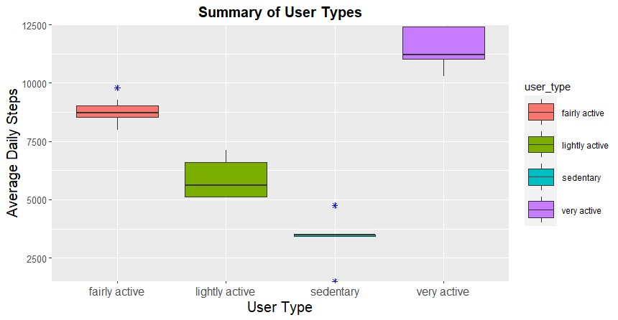
Types of Users
(Based on Step Count)
We can separate the types of users based on their step count into groups such as “Sedentary” being the least till “Very Active” ( the highest ).

Slide 5
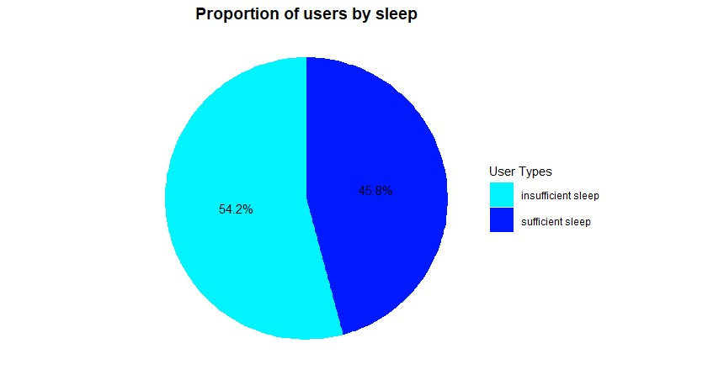
Types of Users
(Based on Sleep)
Proportion of users based on their sleep schedule are also divided.

Slide 6
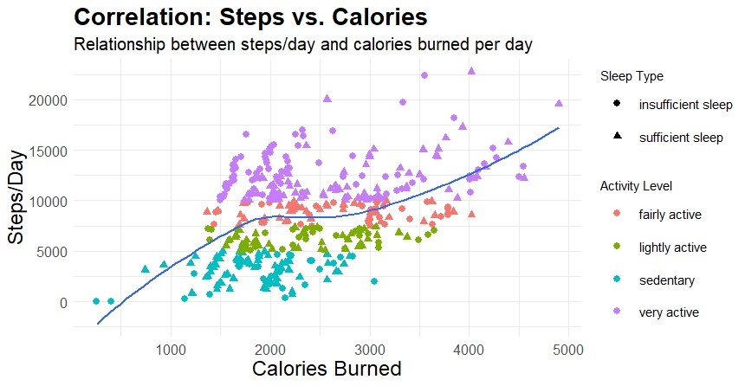
This graph shows the correlation between steps vs calories with respect to their sleep type.

Slide 7
The Problem
- Suggests that even though both have equal number of steps , user with better sleep schedule gets more calories burned.
- Suggests there is calorie being burnt with no steps which is a case of inaccuracy
- Suggests user with better sleep schedule and more steps has burnt less calories as compared to user with an insufficient sleep.

Slide 8
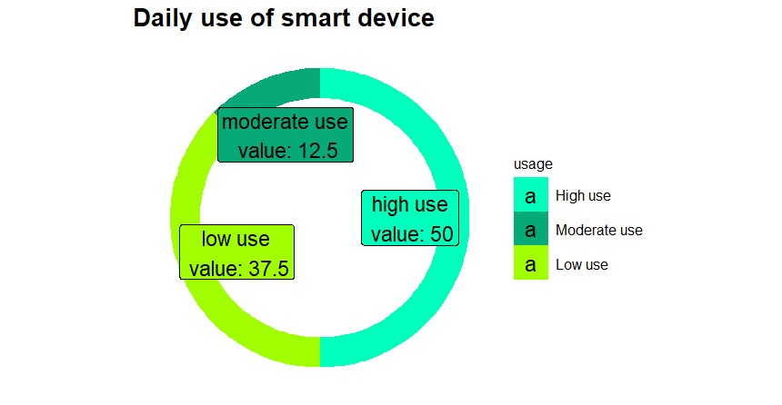
The Reason
The average daily use of the smart device has been less which leads to inaccuracy.
As we can see in the graph , 37.5% don’t use the smart device frequently and 12.5% uses moderately.
This leads to an inaccuracy.

Slide 9
The Solution
The Best Solution would be to gain the usage of device. This can be achieved in two ways :
Increasing the interest within the moderate users by adding a feature like sleep monitor (we saw earlier how much insufficient sleep affects their calories burn rate)
Marketing the smart device again by sending mails , constant notifications thereby making the low usage people to have a conscious of the device ( which will at least guarantee a slight shift from low use to moderate use ) for more accurate results.
Shift from moderate use to high use Shift from low use to moderate use thereby decreasing “low usage” users

Slide 10
THANK YOU.
-Santhosh P

